Slide 1
MY DOC
N.Bharath chandra –RA2111026010376
Y.Roaan reddy – RA2111026010402
A.Sachin varma – RA2111026010403

Slide 2
Contents
1) Introduction of the project
2)Major requirments
3)Benefits
4)Architecture of the app
5)Proposed system
6)Project working
5) Our team members

Slide 3
INTRODUCTION OF THE PROJECT
The proposed project is a smart appointment booking system that provides patients or any user an easy way of booking a doctor’s appointment online. This is a web based application that overcomes the issue of managing and booking appointments according to user’s choice or demands. The task sometimes becomes very tedious for the compounder or doctor himself in manually allotting appointments for the users as per their availability. Hence this project offers an effective solution where users can view various booking slots available and select the preferred date and time. The already booked space will be marked yellow and will not be available for anyone else for the specified time. This system also allows users to cancel their booking anytime.This system allows the users to book nurse and medications all around the clock.The application uses Asp.net as a front-end and sql database as the back-end.

Slide 4
MAJOR REQUIRMENTS-
Connectivity with hospitals
Designing and coding team
Required data of places and budget
Online medical delivery
Execution and testing team

Slide 5
BENEFITS
The project can be implemented in hospitals and clinics It can be utilized by companies and organizations (hospitals, schools, colleges) to automate their parking system.
24*7 booking: Anytime Anywhere.
Organise your schedule better.
Minimise patient no-shows and waiting time
Making employees and staff more productive.
Seamlessly integrates with your Electronic Health Record(EHR)
Access appointments on your computer, laptop and mobile phone.

Slide 6
PROJECT STAGES
The architecture is structured to allow users to make use of portable computer system, desktop computer system, and mobile phone as web browser to access the booking system. Client-server architecture was used and we used thin client-server. The medical appointment booking system has two components namely: the server-side and client-side that run on the browser. In the clientapproach almost all the processing work was done on demand at the server end and the client task was to display data and information on the screen.

Slide 7
While in thin client-server architecture, the web browser is the client. This architecture was used because with it users will not be required to install any software on their PCs expect a standard web browser, which often come, with most PC operating system and almost all the current standard mobile phone. Clients would also not require any powerful PC; users can use any PC with a web browser such as laptop/notebook, mobile phone, and desktop PC. The servers would require higher configuration (in terms of hardware) because it would be regularly subjected to heavy load.

Slide 8
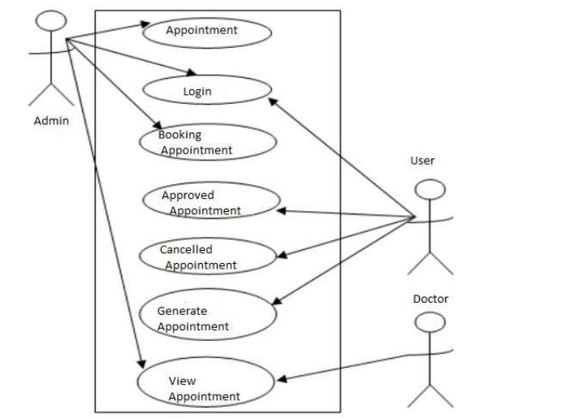
STRUCTURE OF BOOKING SYSTEM-

Slide 9
PROPOSED SYSTEM
The proposed system consists of two panels: Doctor and Patient. The users will first have to download the application and install it in their mobile devices. Once installed, this application will remain into the device permanently until the user deletes it or uninstalls it. The patient will have to register into the application for the first time. On registering, the patient will receive a username and password. The patient can use this username and password for logging into the app each time he uses it. After logging in, the patient will have to select a filtration type. The filtration is done on two bases: Area wise and Specialty wise. After selecting the filtration type, the doctors list will be displayed. The patient can select any particular doctor and view his profile. Also the patient can view the doctors schedule and look for an appointment according to his convenience. The patient will then send a request for appointment. The doctor can either accept the appointment or reject it. The database will get updated accordingly and the patient will get a confirmation message. The add-on to this system is that the patient will receive a notification 2 hours before the actual appointment. This will be very useful in case the patient tends to forget the appointment.

Slide 10
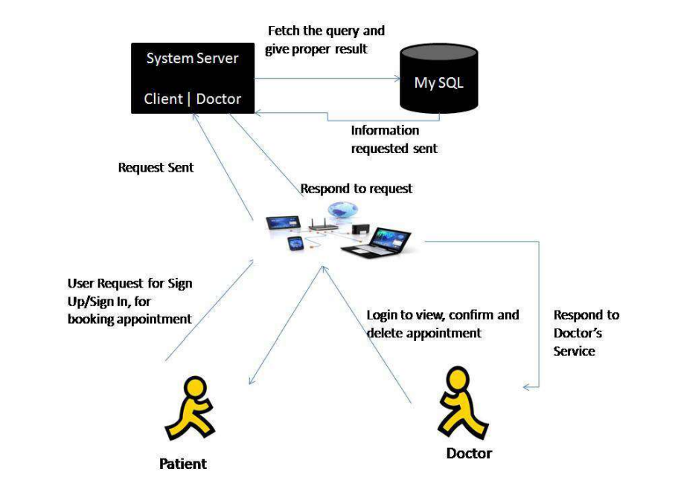
The duration a patient waits from the given time of their schedule to the time that they must actually receive the service is known as direct waiting time. The patients use this technique and waste much waiting time just by standing in queue at the registration counter to make sure a successful registration of the appointment has been made with a certain doctor. The Doctor desires to have some charge over the insanity in the count of patient appointments in a day and the mix of appointments on any given day. These aspects can change their income as well as their carrier comfort levels. The hospital desires to use its resources (staff and apparatus) in the maximum potent way. Therefore the hospital doesn’t desire for the doctor to have long cycle of “wasted time”.

Slide 11
PROJECT WORKING
The user will firstly downloads the application and install it in their mobile devices. Once installed, this application will remain into the device permanently until the user deletes it or uninstalls it. The patient will have to register in the application on first use. After registration, the patient will receive a username and password. For sign up, the user has to fill the given fields that are username, email, password and then the user clicks on the register button to register itself and then all the information provided by the user is saved in the database located on the server.
If we forgot our email or username password then we go to forgot password option And then following screen will be displayed. Here, we have to enter our mobile number on which our OTP will come. When OTP comes on your mobile then it will be your new password and with the help of this password we can register login page.
After logging in, the login page screen is displayed dashboard .Dashboard containing specialists of doctors like Cardiologists, Family physicians, neurologists, ophthalmologists.

Slide 12
If the patient selects the specialist option then he/she can view a list of that types list of doctors. Then the patient selects the particular doctor. Here we select the family physician and then he can view the list of family physician doctors.
Select one of doctor from the list of doctors for view details about doctor. In following screenshot we can see image and information about the particular doctor. The patient can select any particular doctor and view his profile by clicking on the available doctors or by selecting the doctor’s option from the menu screen.
It is a customer review from this we can guess which doctor is better. It is type of feedback and we can also add comment to click on add comment button for this doctor in it.

Slide 13
REFERENCES-
Yeo Symey, Suresh Sankaran arayanan, Siti Nurafifah binti Sait “Application of Smart Technologies for Mobile Patient Appointment System”, International Journal of Advanced Trends in Computer Science and Engineering, august 2013 6.
Jagannath Aghav, Smita Sonawane, and Himanshu Bhambhlani “Health Track Health Monitoring and Prognosis System using Wearable Sensors”, IEEE International Conference on Advances in Engineering & Technology Research 2014,

Slide 14
TEAM MEMBERS
N.Bharath
A.Sachin
Roaan Reddy
THANK YOU

